Slide 1
VQA-E: Explaining, Elaborating, and Enhancing Your Answers for Visual Questions
Qing Li, Qingyi Tao, Shafiq Joty, Jianfei Cai, Jiebo Luo

Slide 2
Outline
Introduction
VQA-E Dataset
Explanation Synthesis
Dataset Analysis
User Study
Multi-task Model
Experiments
Conclusions

Slide 3
Visual Question Answering
AI System
Q: What team does the man play for?
A: Boston

Slide 4
Visual Question Answering with Explanation
Visual Explanation
Attention map, unsupervised,
inaccessible to blind people.
AI System
Q: What team does the man play for?
A: Boston
Notes:
The visual explanation is implicit and unsupervised (learnt by the model itself, thus influenced by language bias). And there could be many cases where the model attends to right regions but predicts wrong answers. What's worse, the visual justification is not accessible to visually impaired people who are the potential users of the VQA techniques.

Slide 5
Visual Question Answering with Explanation
Visual Explanation
Attention map, unsupervised,
inaccessible to blind people.
Textual Explanation
AI System
Q: What team does the man play for?
A: Boston
E: A man wearing a Boston jersey.

Slide 6
The Benefits of Textual Explanations
Be accessible to visually impaired people.
Provide beneficial feedbacks to extend the conversation.

Slide 7
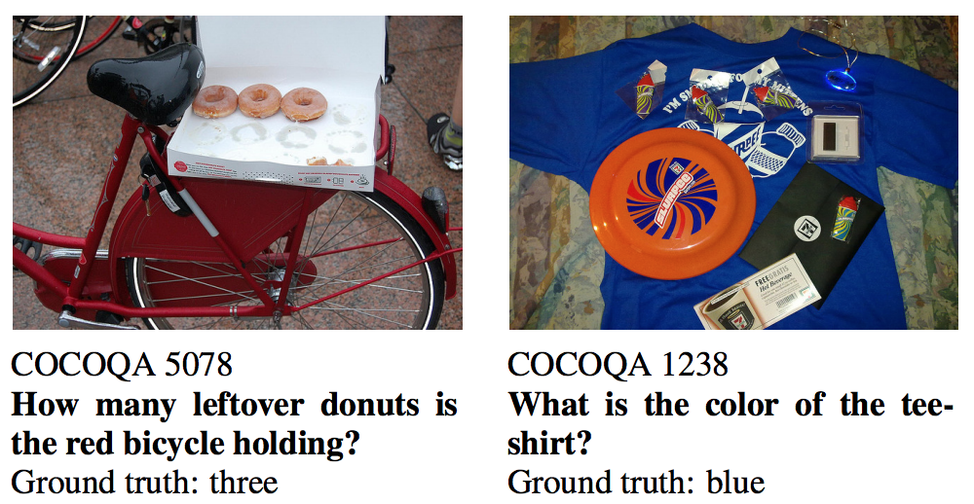
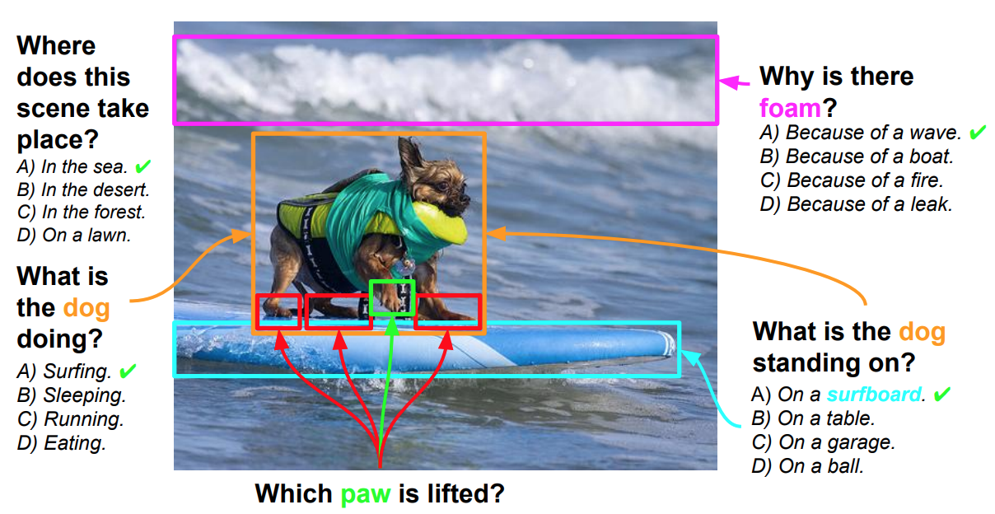
Current VQA Datasets
Toronto COCO-QA (NIPS'15)
Short answers and
No explanations!
Visual7W (CVPR'16)
VQA (ICCV'15, CVPR'17)

Slide 8
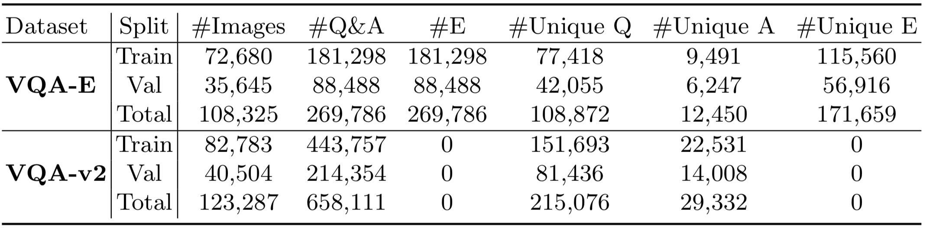
Proposed VQA-E Dataset
> 108K images (from COCO), ~270K <Q, A, E> pairs
Explanations are synthesized, paired with confidence scores.

Slide 9
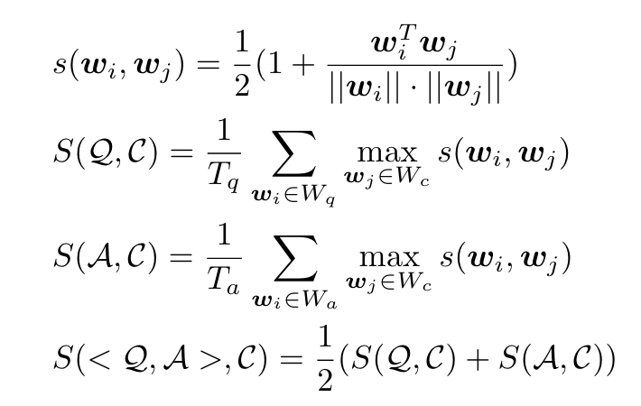
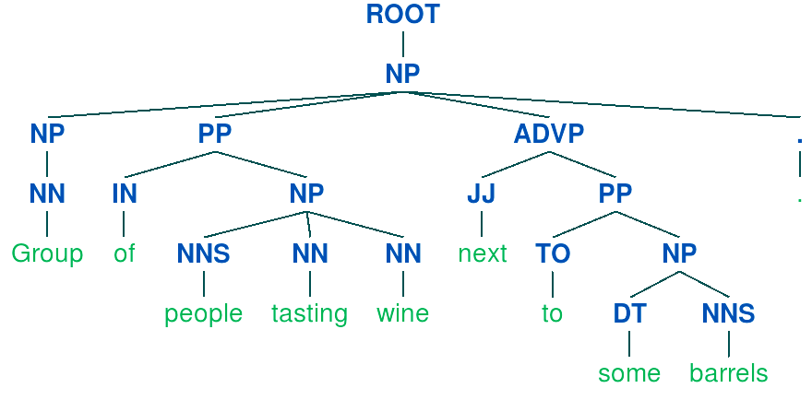
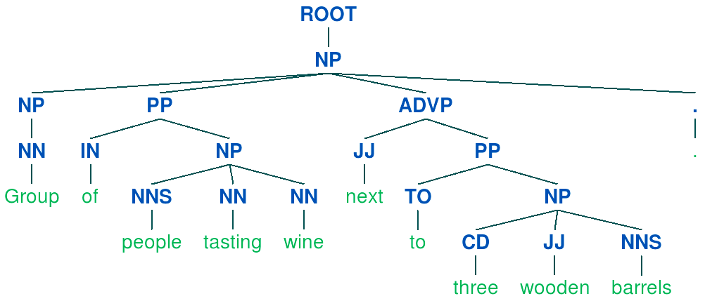
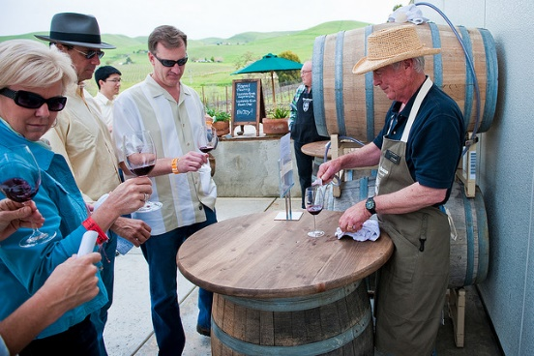
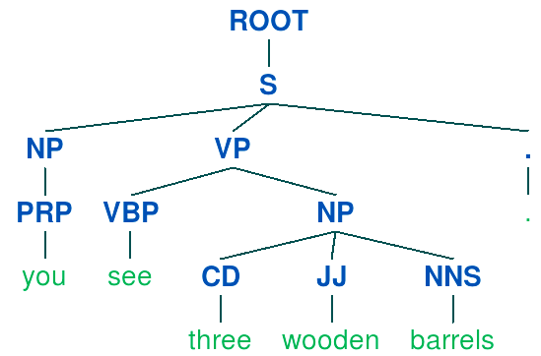
Explanation Synthesis
Find the most relevant caption:
C: Group of people tasting wine next to some barrels.
Q: How many wooden barrels do you see?
A: 3
S: You see three wooden barrels.
E: Group of people tasting wine next to three wooden barrels.

Slide 10
Similarity Distribution
We set a threshold of 0.6 to remove bad explanations.

Slide 11
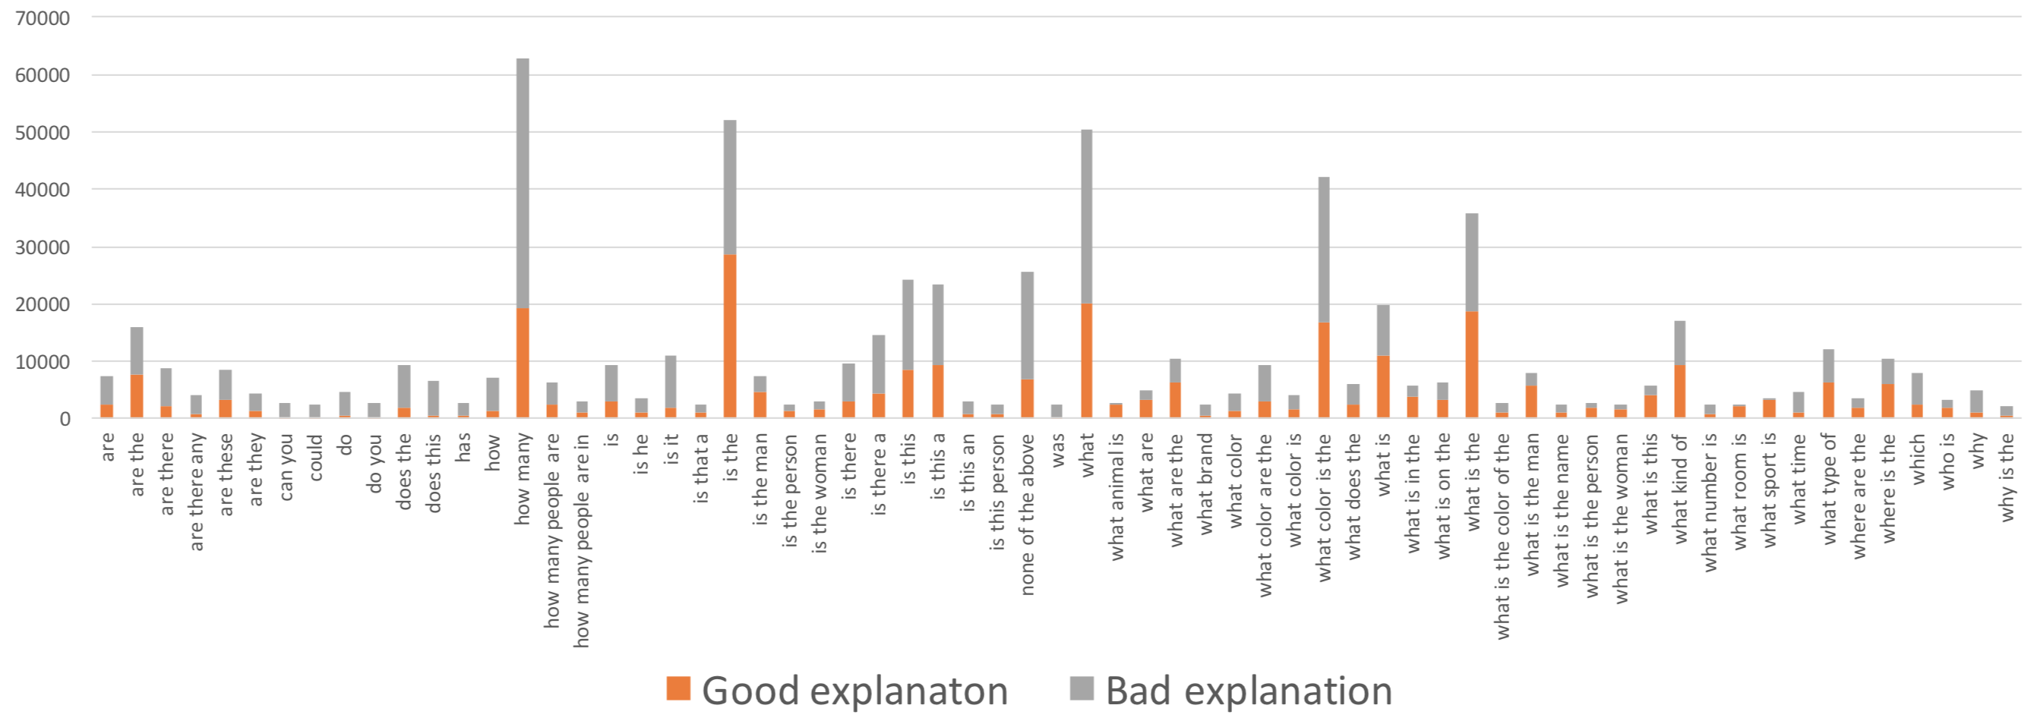
Specific v.s. Abstract v.s. Subjective Questions
~40%
~90%
~6%
Notes:
Different question types get different percentage of good explanations

Slide 12
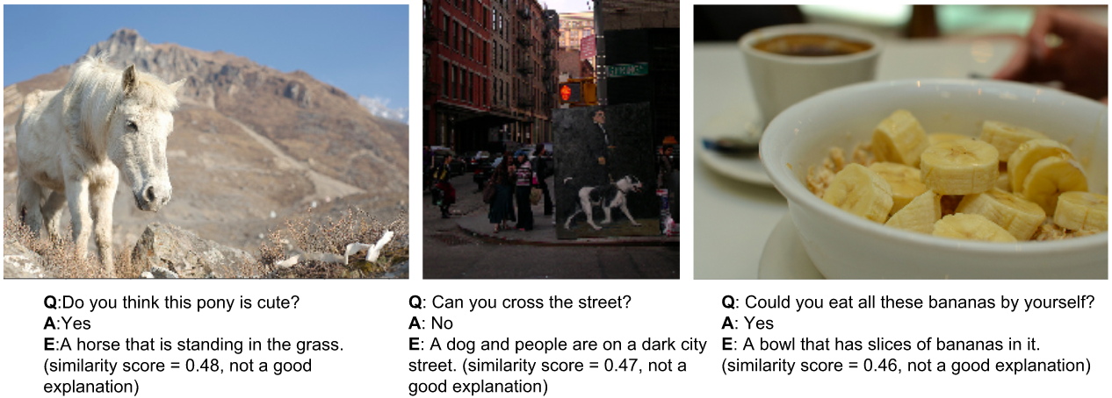
Subjective Examples
Require commonsense knowledge!

Slide 13
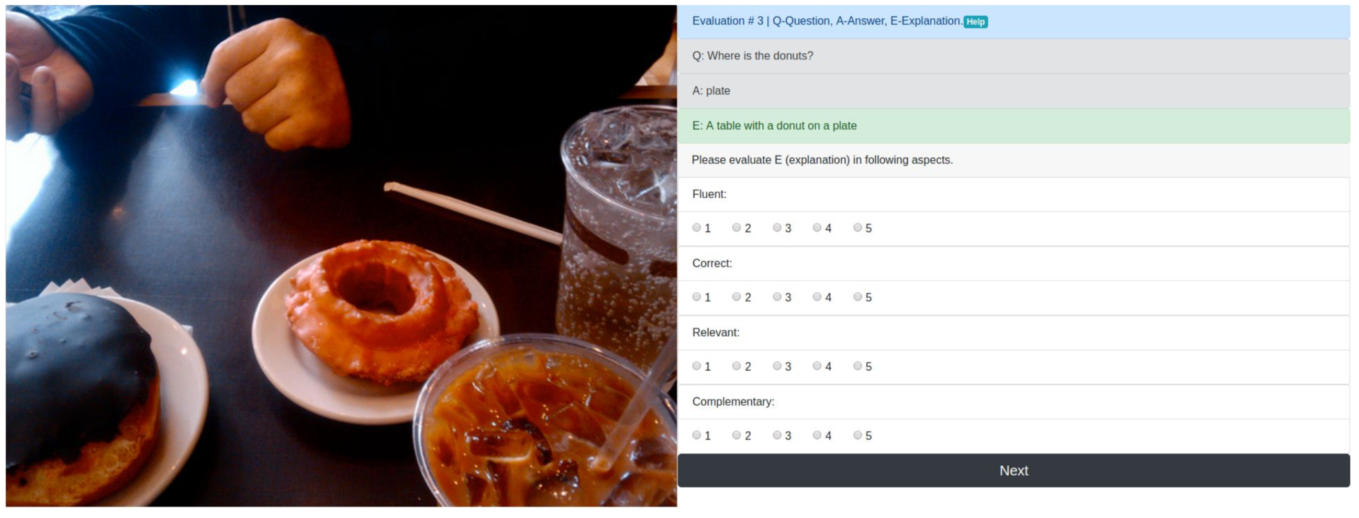
Dataset Assessment – User Study
20 Subjects, 2,000 <Q, A, E> pairs
fluent, correct, relevant, complementary
1-very poor, 2-poor, 3-barely acceptable, 4-good, 5-very good.
Notes:
○ Fluent:
■ Is this E a fluent English sentence/phrase? A fluent E should be correct in grammar and idiomatic in wording.
○ Correct: ■ Is this E is correct according to the image content? A correct E should describe the image content precisely.
○ Relevant: ■ Is this E relevant to the question? If an E is relevant, you should be able to infer the answer from E.
○ Complementary:
■ Is this E complementary to the Q&A? If an E is complementary, it should provide complementary information that describes the details related to the question and answer.
Relevance and Complementary differentiate a general caption of an image and a specific explanation dedicated for a visual question-answer pair.

Slide 14
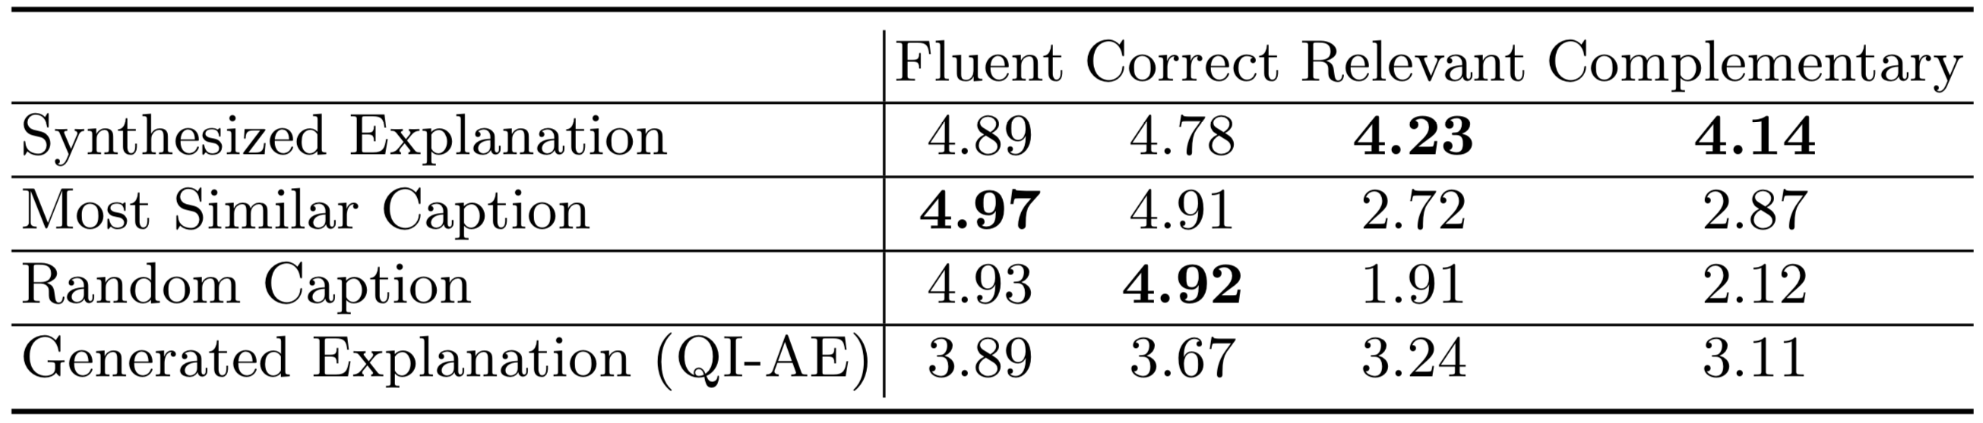
User Study Results
Notes:
Relevance and Complementary differentiate a general caption of an image and our specific explanation dedicated for a visual question-answer pair. their scores are both above 4, which indicates that the overall quality of the explanations is good from human perspective.

Slide 15
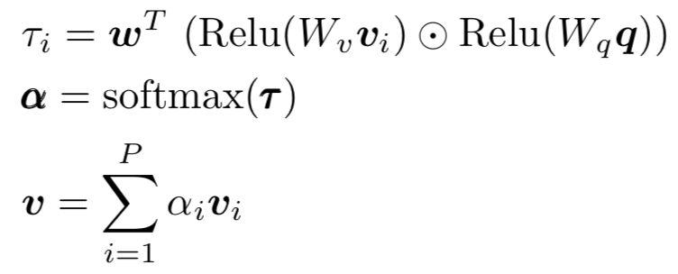
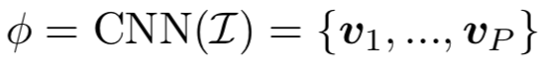
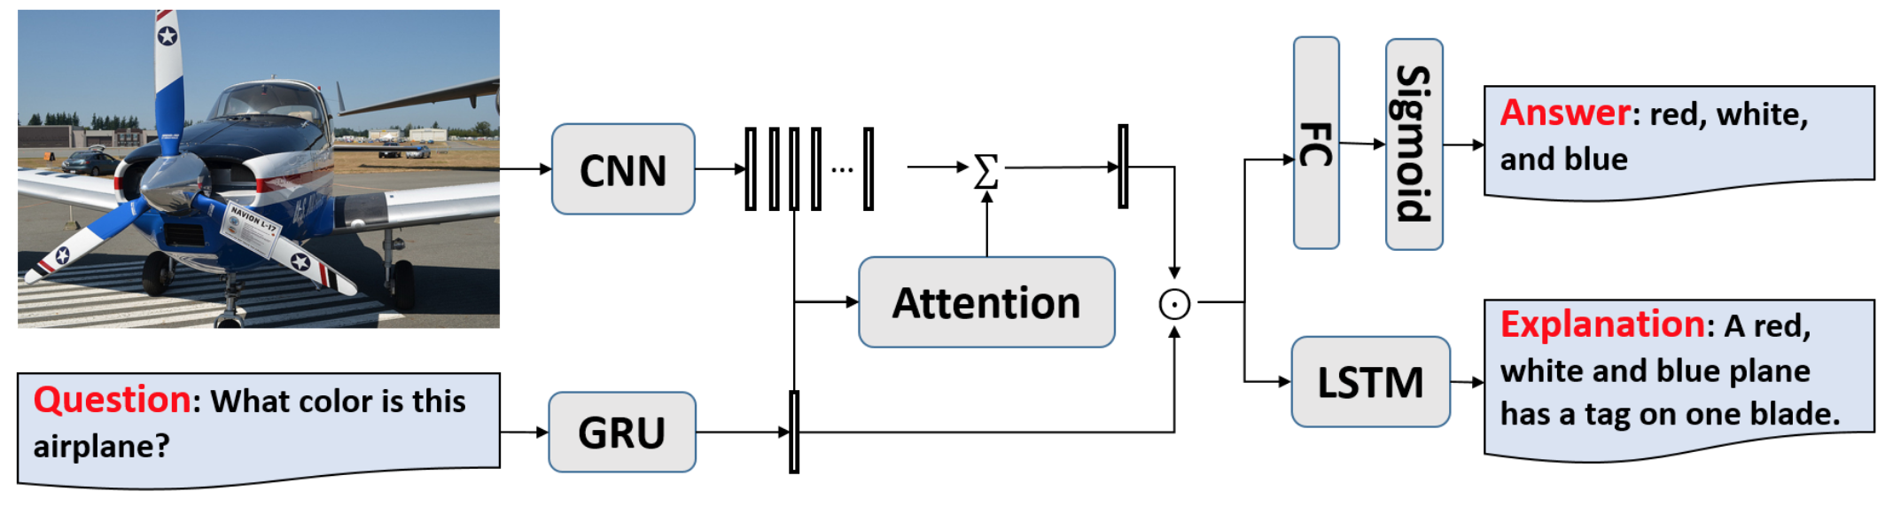
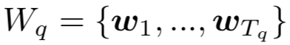
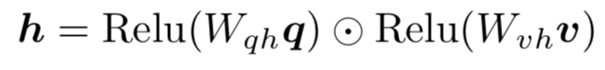
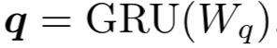
Multi-task VQA-E Model

Slide 16
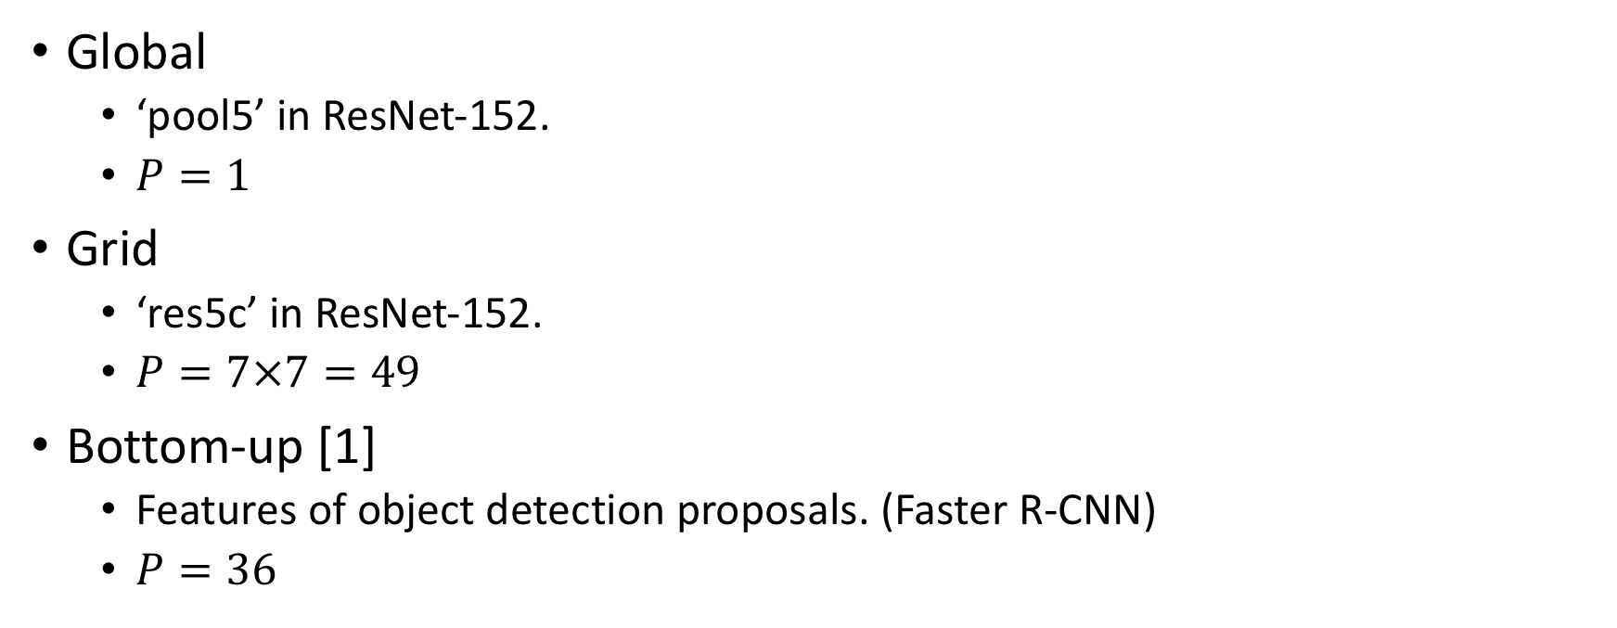
Variant Image Features
Global
‘pool5’ in ResNet-152.
$P=1$
Grid
‘res5c’ in ResNet-152.
$P=7×7=49$
Bottom-up [1]
Features of object detection proposals. (Faster R-CNN)
$P=36$
[1]. Anderson et al. “Bottom-Up and Top-Down Attention for Image Captioning and Visual Question Answering” (CVPR'18)

Slide 17
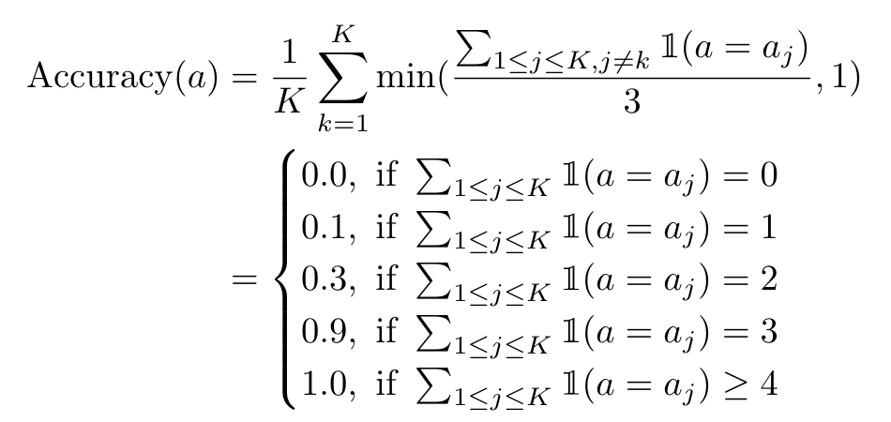
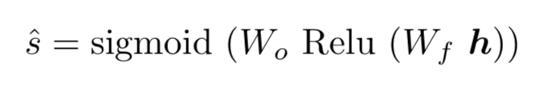
Soft Target in Answer Prediction
Multi-label regression problem:

Slide 18
Model Variants
Q-E: generating explanation from question only.
I-E: generating explanation from image only.
QI-E: generating explanation from question and image and only training the branch of explanation generation.
QI-A: predicting answer from question and image and only training the branch of answer prediction.
QI-AE: predicting answer and generating explanations, training both branches.
QI-AE(relevant): predicting answer and generating explanation and training both branches. The explanation used in this variant is the relevant caption obtained in the process of explanation synthesis.
QI-AE(random): predicting answer and generating explanation and training both branches. The explanation is randomly selected from the ground-truth captions for the same image except the relevant caption.

Slide 19
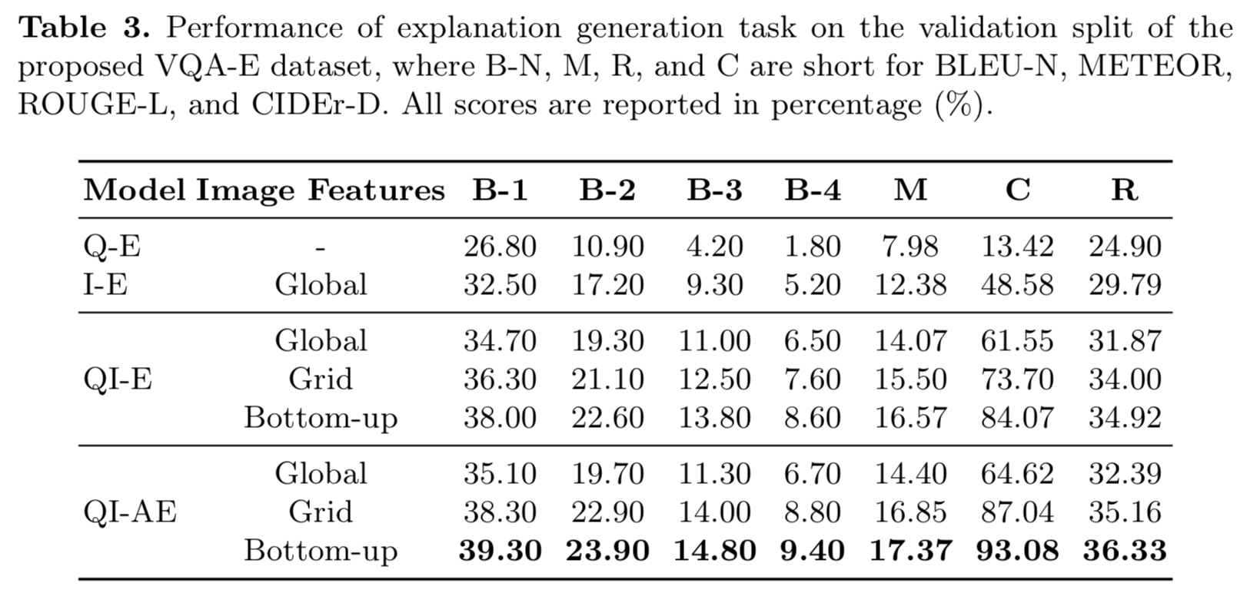
Evaluation of Explanation Generation

Slide 20
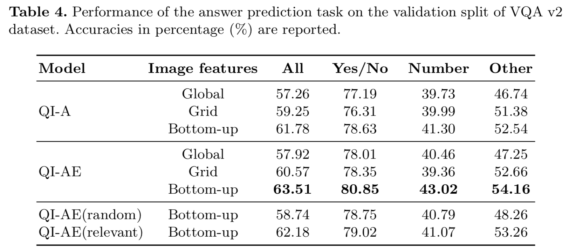
Evaluation of Answer Prediction

Slide 21
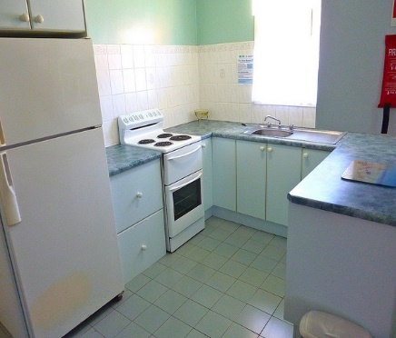
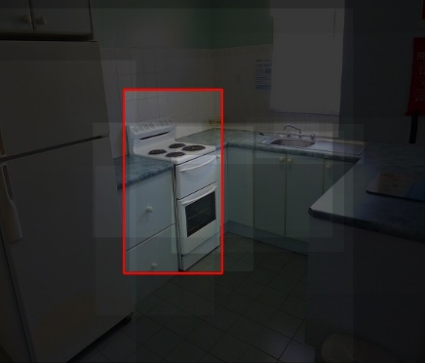
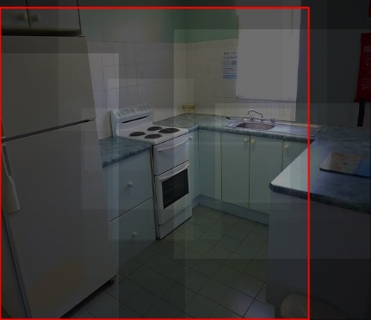
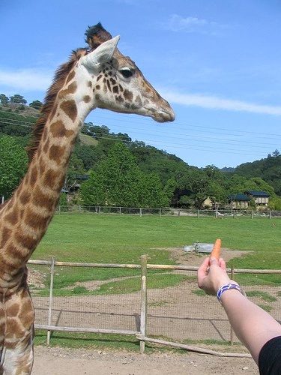
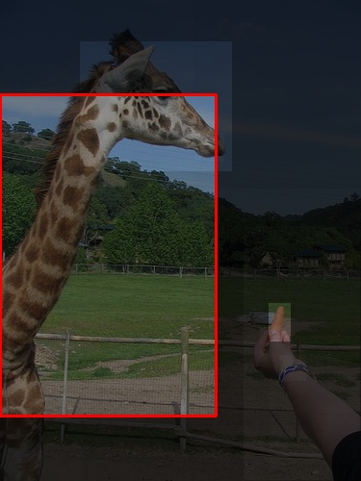
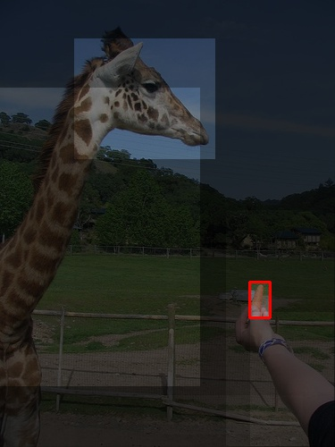
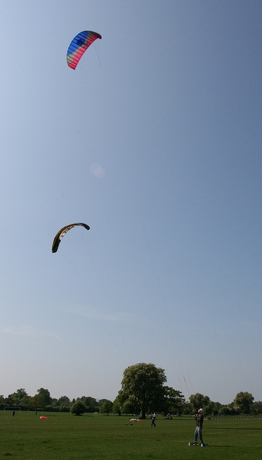
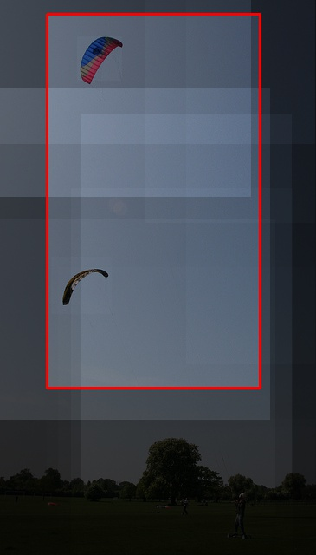
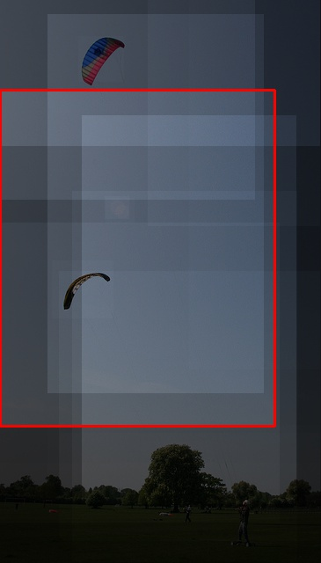
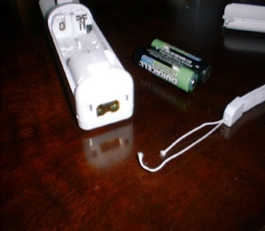
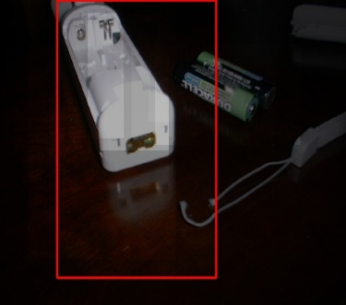
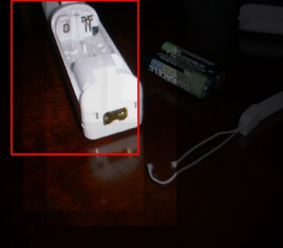
Qualitative Examples
(a)
Is this a kitchen?
(b)
What is the person doing?
Yes, the kitchen is clean and light comes in the window.
No.
Yes, a kitchen with a fridge, sink , and cabinets in it.
Feeding giraffe, a close up of a person feeding a giraffe
Standing.
Feeding giraffe, a person feeding a giraffe.
(c)
Is this a sunny day?
(d)
What color is the remote?
White, white controller sitting on top of a wooden table next to a battery.
White.
White, a white controller sitting on a table.
Yes, kites being flown in a park on a sunny day.
No.
Yes, a kite flying in the air on a sunny day.
Ground truth
QI-A
QI-AE
Ground truth
QI-A
QI-AE

Slide 22
Conclusions
We propose a new dataset (VQA-E) to promote research on justifying answers for visual questions
Synthesized explanations are of high quality for visually-specific questions.
Inadequate for subjective questions which require commonsense.
We propose a novel multi-task learning framework for VQA-E
The additional supervision from explanations helps the model better localize and understand the important image regions.

